Slide 1
Lecture 5: Understanding Global Money
Perry Mehrling
Warsaw School of Economics
October 18, 2017

Slide 2
International Hierarchy of Money
Dollar
C6 Swap Line
Bilateral Swaps, Regional Pooling, IMF
National Money
National Credit

Slide 3
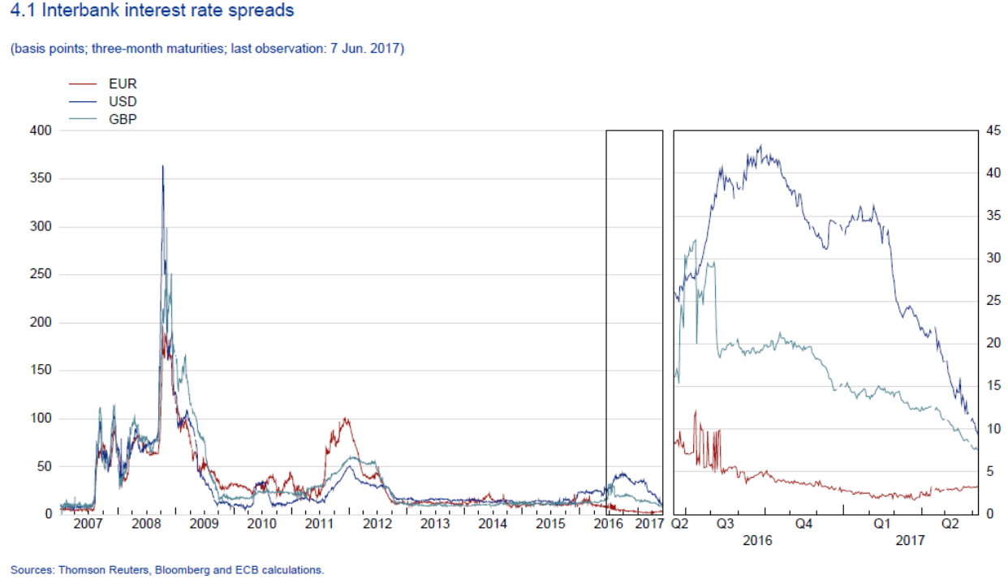
Dollar Shortage—Forward Par
Source: ESRB Risk Dashboard

Slide 4
Dollar shortage—Covered Parity
Source: ESRB Risk Dashboard

Slide 5
Global Money is … the Eurodollar
Private money: issued by banks not a sovereign
Credit money: promise to pay not final settlement
Dollar money: promise to pay dollars not euros, yen, RMB

Slide 6
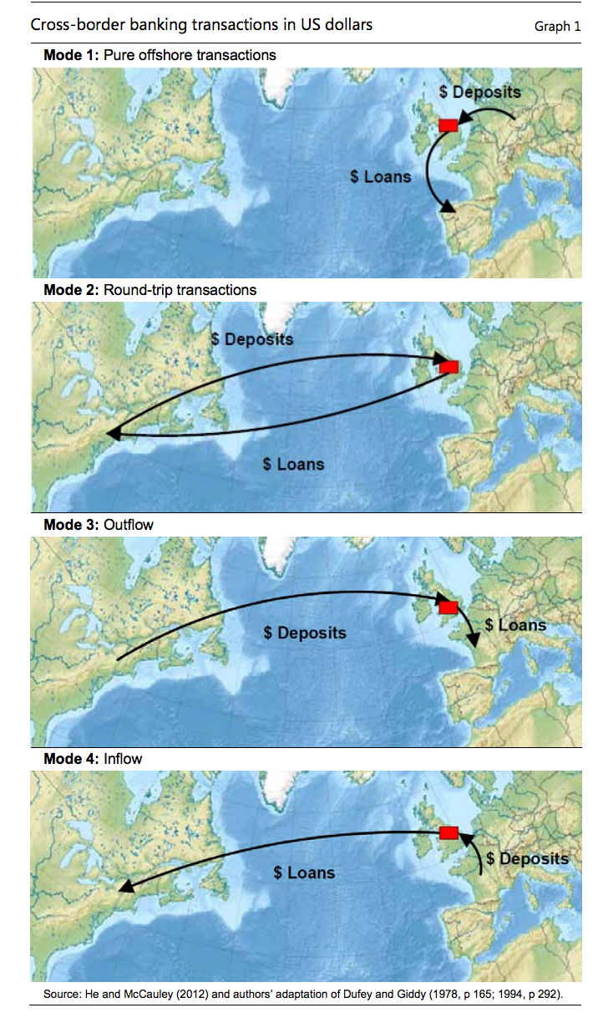
Financial Center is…London
Avjiev, McCauley and Shin, 2014.

Slide 7
Price of global money is … a liquidity spread
Private money implies inherent hybridity
Management of par: TED spread, LIBOR-OIS
Credit money implies inherent instability
Management of interest rate: term spread, IRS spread
Dollar money implies inherent hierarchy
Management of exchange rate: FX basis swap

Slide 8
Management of global money is … essentially hybrid
Private dealer of first resort
Inside spread (par, interest rate, FX)
Normal crisis
Public dealer of last resort
Outside spread (par, interest rate, FX)
Serious crisis

Slide 9
International Monetary System is…Inherently Hierarchical
Spectrum of hybridity
Reserve currency: deep and liquid dealer markets, central bank backstop only
Peripheral Currency: central bank as market maker
Intermediate Cases
Exchange Rate Regimes
Floating
Fixed
Intermediate

Slide 10
Global Banking is … “shadow banking”
“Shadow Bank” Global Money Dealer Asset Manager
Derivative Dealer
Assets | Liabilities | Assets | Liabilities | Assets | Liabilities
FX loans CDS IRS FXS | $ MM funding | $ MM funding | “deposits” | “deposits” | Capital CDS IRS FXS
Assets | Liabilities
Credit Default Swaps Interest Rate Swaps Foreign Exchange Swaps | Credit Default Swaps Interest Rate Swaps Foreign Exchange Swaps

Slide 11
Management of Global Banking is … essentially hybrid
“Shadow Bank” Global Money Dealer Asset Manager
Derivative Dealer
Assets | Liabilities | Assets | Liabilities | Assets | Liabilities
FX loans CDS IRS FXS | $ MM funding | $ MM funding Reserves Liquidity Put | “deposits” Capital Solvency Put | “deposits” | Capital CDS IRS FXS
Assets | Liabilities
Credit Default Swaps Interest Rate Swaps Foreign Exchange Swaps Reserves Liquidity Put | Credit Default Swaps Interest Rate Swaps Foreign Exchange Swaps Capital Solvency Put

Slide 12
Global Money is … essential infrastructure
Globalization of Finance
Post WWII, rise of private capital markets (New York)
Post Bretton Woods, rise of private money markets (London)
Shadow Banking as Integration of Global Finance and Global Money
From bank loan-based credit to capital market-based credit
Quintessential institutional form for modern day
Money and Finance is … essential infrastructure
Banking as payments system (settlement discipline)
Banking as market-making system (pricing money and risk)

Slide 13
Global Governance is … a work in progress
Liquidity is private and global, but backstops are public and local
Adequacy of liquidity swap network?
Political economy of the Fed?
Relocating and reorienting the backstop function
Money: markets not banks, global not local, liquidity not solvency
Risk: DOLR not LOLR, outside spread not inside, liquidity not solvency
Micro and macro prudential regulation?
Monetary and financial stabilization policy?

Slide 14
Needed … a robust dealer of first resort
Retreat from cross-border banking (home bias)
Private decisions, regulatory pressure, or both?
Headwinds to short-term capital flows, survival constraint discipline
Retreat from market-making (market liquidity)
Money market dealing
Derivative dealing (IRS, CDS, FXS)
Relocating and reorienting the dealer function
Money: cash pools and wholesale money market
Risk: separation of prop trading and matched book CCP

Slide 15
Global System means …. Global Crises
Bretton Woods Era, national crises
Post Bretton Woods, regional crises
Modern Financial System, global crises
2007-9, $ money funding of $ capital lending
20??, $ money funding of FX capital lending

Slide 16
Financial Deepening and Integration of EME
Turner and Shin (2015), Acharya et al (2015)
 | Bank-Based Credit | Market-Based Credit
Local Currency | Pre-GFC Non-Sovereign | Post-GFC Sovereign
Global Currency | Pre-GFC Sovereign | Post-GFC Non-Sovereign

Slide 17
Present State of Play: Non-US dollar funding

Slide 18
Present State of Play: market-based credit
Money Market Funding→→

Slide 19
EME Debt Bubble (BIS 8/16)

Slide 20
EME Dollar Borrowing (BIS 12/15)

Slide 21
EME dollar lending (BIS 9/16)

Slide 22
Liquidity Preference, then …
Circa 1965, CPKindleberger versus Modigliani/Triffin
United States Europe
Assets | Liabilities | Assets | Liabilities
$loans $bonds | $deposits | $deposits | $loans $bonds

Slide 23
…and now
Shadow Banking: origin of GFC, backstopped by Fed
United States Europe
EME Dollar Borrowing: origin of next crisis? backstopped how?
EME Non-US ROW
Assets | Liabilities | Assets | Liabilities
$MM funding | $RMBS | $RMBS | $MM funding
$reserves | $loans $bonds | $loans $bonds | $MM funding

Slide 24
Liquidity in a Matched Book World
CFB GMD AM
DD
Blocking a Liquidity spiral: LOLR to dealers, DOLR to RMBS and swaps, especially FXS
Assets | Liabilities | Assets | Liabilities | Assets | Liabilities
RMBS 100 CDS 0 IRS 0 FXS 0 | MM 100 | MM 100 | Deposit 100 | Deposit 100 | Capital 100 CDS 0 IRS 0 FXS 0
Assets | Liabilities
CDS 0 IRS 0 FXS 0 | CDS 0 IRS 0 FXS 0

Slide 25
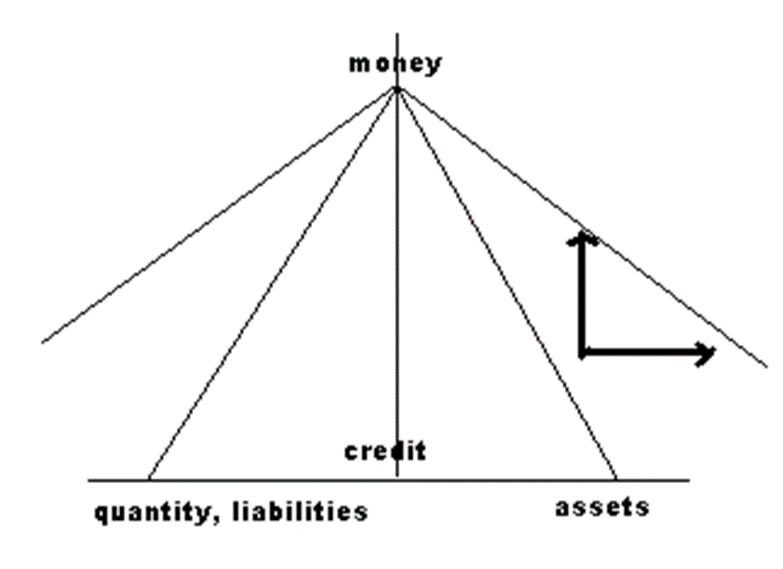
Global Money is … Inherently Unstable

Slide 26
What is at stake?
“What is liable to happen, if there is a failure of international credit, is that nations will turn in upon themselves, becoming more autarkic and more protectionist, impoverishing themselves and each other by refusing to trade with each other….The remedy would be an International Central Bank, an International Bank which would underpin the credit structure, but in order to underpin it must have some control over it. That was what Keynes, who understood this international aspect very clearly, wanted to get at Bretton Woods; but all he got was a Currency Board—the IMF.”
(Hicks, “Monetary Theory and History” 1967)

